Slide 1





Python Workflows with ArcGIS
Alexander Brown – Solution Engineer
Piyali Kundu – Solution Engineer
Esri Python API Workshop | March 26, 2019
Notes:
G97350 UC Template for Esri staff

Slide 2


Agenda
Introduction
Querying using the Python API
Overwriting Content Using CSV
Enterprise Workflows
Add/Delete/Update
Truncate & Append
Overwriting Content with Service Definitions
Conclusion

Slide 3


ArcGIS Python API
What is it?
Python API to your Web GIS
Powerful, modern and easy to use
Implemented using REST

Slide 4
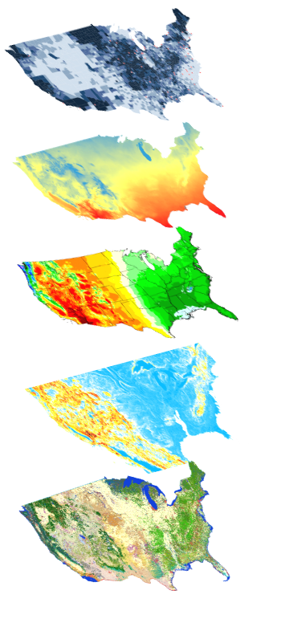
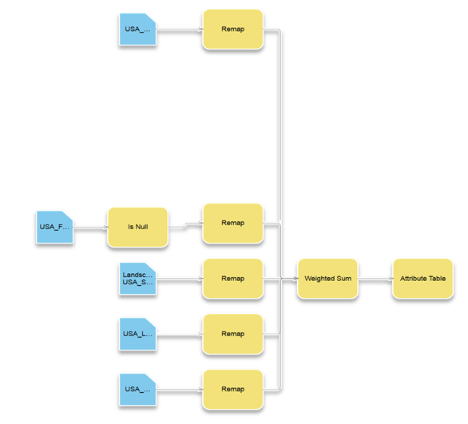
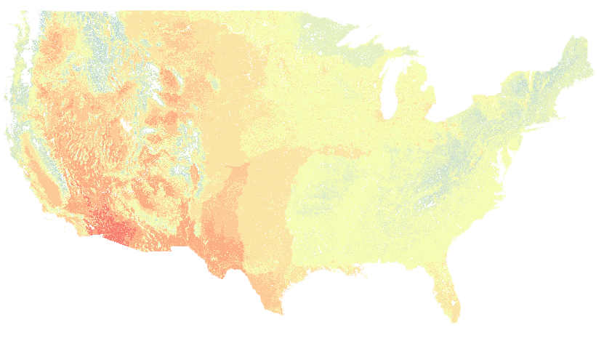

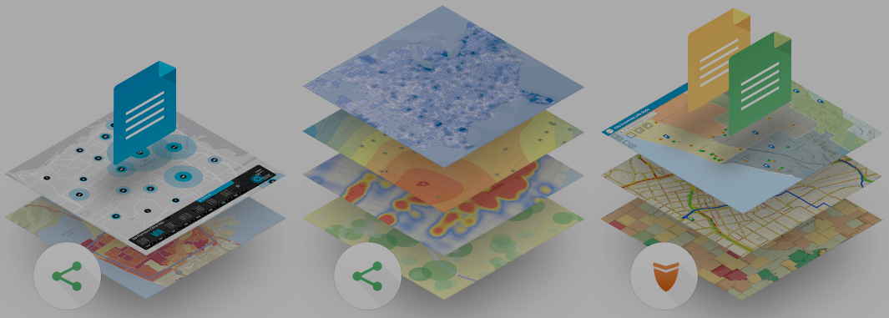
ArcGIS Python API
Big Data
Spatial Analysis
Raster Analytics
What can it do for you?
Imagery
Location Analytics
Feature Analytics
Platform API
Power Users
Developers
Analysts
Data Scientists
Enterprise Integration
Users, Roles & Group management
Administrators
DevOps
Content Publishers
Your Web GIS
Script and automate your Web GIS
Data Management

Slide 5
Automate WebGIS management
Reproducible research
What can it do for you?
Populate portal with users, groups
Clone portals
Reassign user content
Perform comprehensive content search
Determine item relationship
Create reports of users, their items
Access big data tools programmatically
Utilize rich 3rd party Python packages for data analysis
Create rich charts, graphs, embed 2D and 3D maps in Jupyter Notebook environment
Share your research with data and notes with peers
Automate content creation
Automate content publishing during off peak hours
Update tiles and features from a known database
Replicate development environment content to production
Inspect and update items with broken service links
Notes:
How can all 3 personas benefit from the API?
- Admins, instead of using the UI and getting distracted from their work, can automate most of their common workflows as scripts and schedule them to run at periodic intervals
- Publishers can take care of repetitive content creation and content validation workflows through scripts and schedule them to run at known times
- scientists all over in every discipline love the Jupyter notebook environment. We have added our own enhancements in the form of widgets. Analysts can prototype algorithms, inspect datasets, and visualize their datasets. They can finally share all their work, notes, outputs as Jupyter notebooks, or publish them as html pages to their blogs.

Slide 6
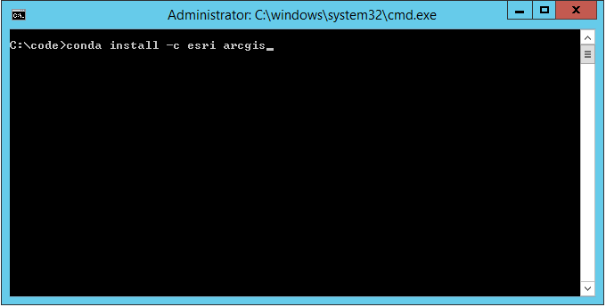
How do you get this?
Distributed via Conda
Simplifies installs & updates
Installs dependencies
Avoids conflicts
Install steps:
Download Anaconda
conda install –c esri arcgis

Slide 7
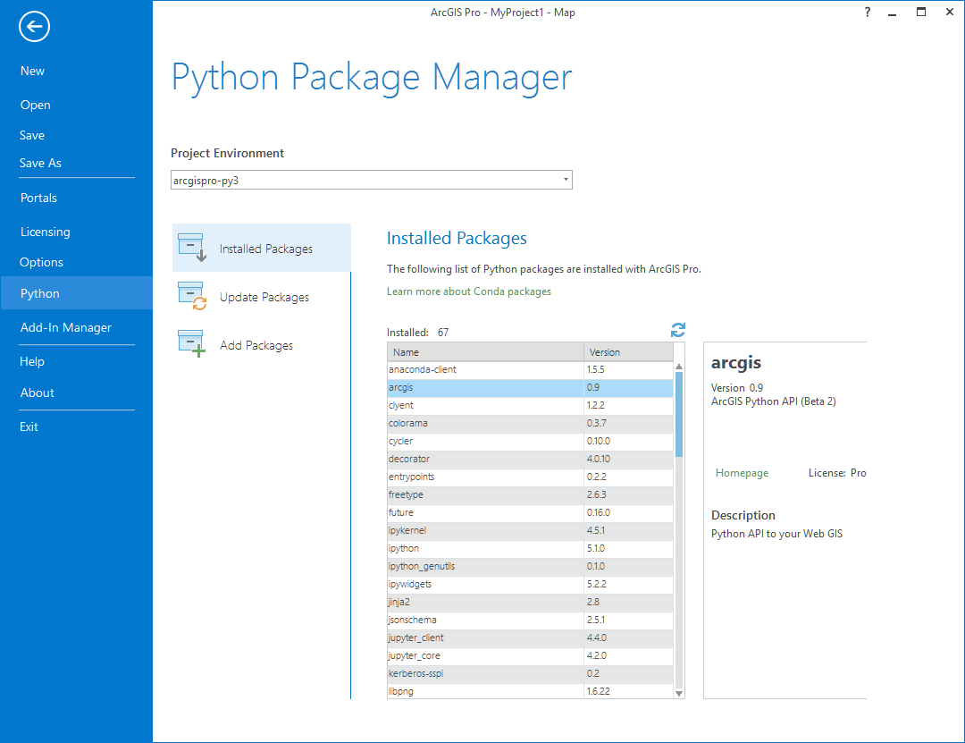
Have ArcGIS Pro?
ArcGIS Pro includes conda
Follow steps from install guide to install arcgis package...

Slide 8
API Overview
geo
analytics
Pythonic GIS API
gis
geo
processing
geocoding
geometry
features
realtime
env
mapping
widgets
raster
network
schematics
Notes:
The ArcGIS Python API is not just another API for the ArcGIS ecosystem. Instead, it is GIS represented in Python! Such an API must be intuitive to a developer without a GIS introduction. To that end, we designed the API to be modular with self contained objects and tools.
This diagram presents the modules present in the API. The gis module is the main and entry point into your GIS. It encapsulates the concept of a web gis effectively allowing you to represent users, content, groups as Python objects and perform actions on them. GIS admins spend a lot of time on this module.
The modules in green are used to access layers / content of particular type. Such layer objects allow you to query data and perform geoprocessing tasks on them.
The modules in blue are used to access tools on your web gis. Most of these tools accept layer objects as input and work on them. Some return an in memory output like a feature collection while the remaining can persist the outputs as web layers on your portal.
The modules in yellow allow you to visualize your content. Talking of widgets, the API ships with extensions for Jupyter notebooks. Jupyter notebooks are a popular IDE to prototype and visualize content among Python developers and scientists.

Slide 9
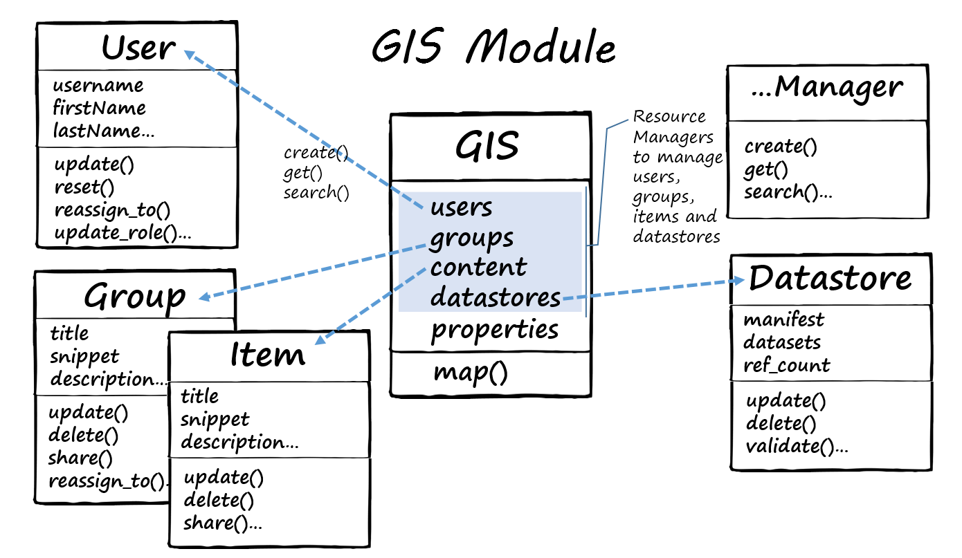
The GIS Module
A GIS represented using Python
Notes:
The gis module provides an information model for GIS hosted within ArcGIS Online or an ArcGIS Portal. This module provides functionality to manage (create, read, update and delete) GIS users, groups, content and datastores. This module is the most important and provides the entry point into the GIS.
Everyone starts with this module - GIS admins spend a lot of time on this module.
http://esri.github.io/arcgis-python-api/apidoc/dev/html/arcgis.gis.html
The GIS class has helper components that reflect the conceptual components of a GIS discussed above. The content, datastores, users and groups properties provide helper objects that let you manage the corresponding entities in the GIS using similar patterns. You can add()/create(), get() or search() for these GIS resources (i.e. Items, Datastores, Groups and Users respectively) and once you have obtained a reference to these resources, you can access their properties and call methods on these objects.
The map() method on the GIS object creates a mapping widget that can be used in the Jupyter notebook environment for visualizing GIS content as well as the results of your analysis.

Slide 10
Demo 1: Introduction to the ArcGIS Python API & Jupyter Notebook
File: 1_Introduction
Connect to the GIS
View item information
Visualize items in a map
Work with Spatially Enabled Data Frames

Slide 11
Practical Workflows for Overwriting Content
Enterprise Data Movement
Enterprise Workflows
Add/Delete/Update
Relevant for smaller datasets
Feature or groups of Features
JSON Syntax
Truncate & Append
Small, medium datasets (30K : 600K or less)
Groups of Features
FGDB, Shapefiles, CSV, GeoJSON
Overwriting Content with Service Definitions
Best for largest datasets (600K or greater), also works well for small/medium
Entire datasets
Service Definition files utilizing ArcGIS Pro or ArcMap

Slide 12
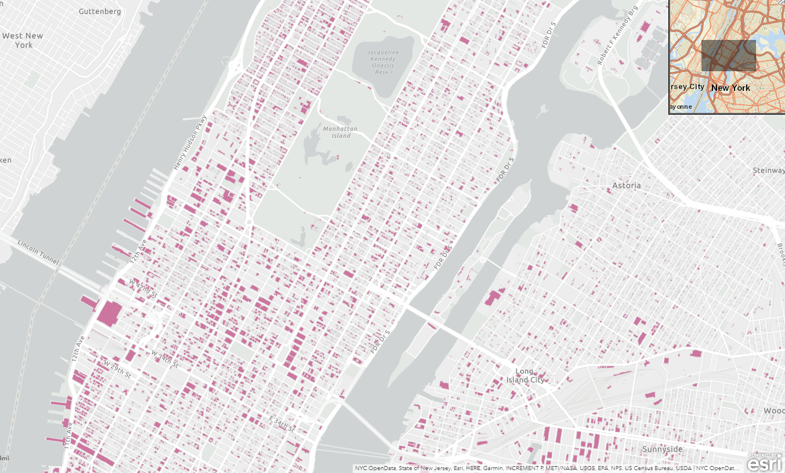
Practical Workflows for Overwriting Content
Enterprise Example
NYC Building Footprints – ArcGIS Online
1.08 million complex Polygons
Add/Delete/Update
700 Records at a time
3 Hours 15 mins
544K features written (50%) of dataset
Truncate & Append
200K Record Sets
FGDB (no schema matching programmatically)
1 hour 5 Minutes
Overwriting Content with Service Definitions
30 minutes
Premium Data Stores in ArcGIS Online reduce total publishing time; i.e M1 = 12 minutes

Slide 13
Demo 2: Connect to native Database publish data
File: 2_Overwrite_NYC_csv
Query SQL Server database table
Export to csv
Connect to GIS
Publish Dataset

Slide 14
Demo 3a: Connect to Socrata
File: 3a_Socrata_Query
Connect to Socrata
Manipulate Data
Export to CSV
Publish Dataset

Slide 15
Demo 3b: Connect to Socrata
File: 3a_Socrata_Query
Connect to Socrata
Manipulate Data
Export to CSV
Publish Dataset

Slide 16
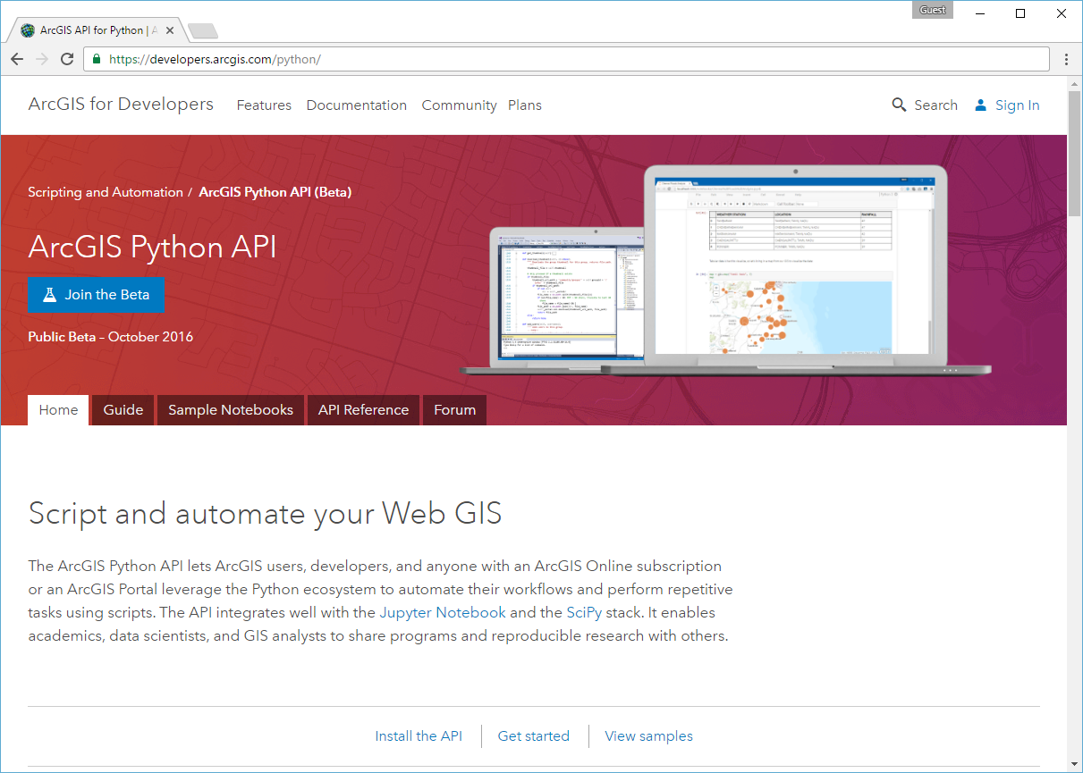
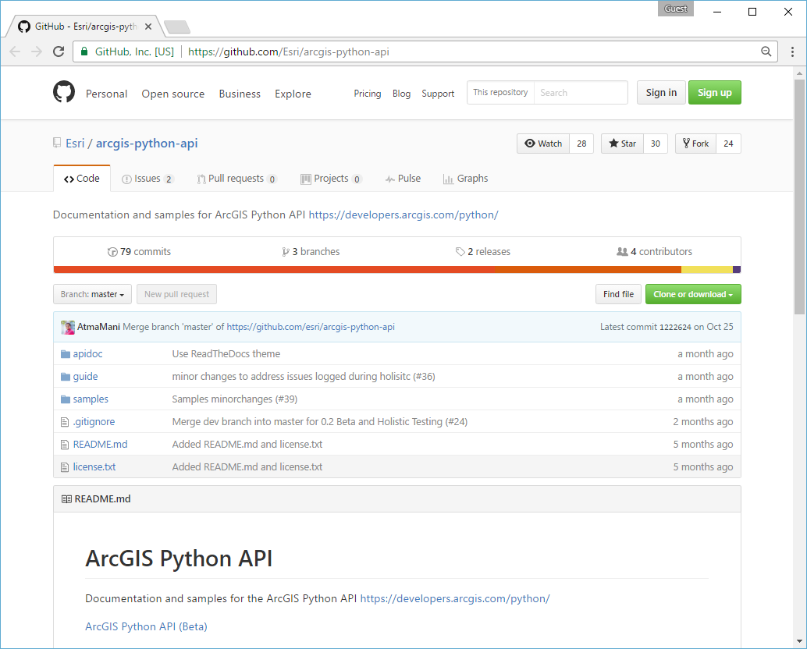
Resources
developers.arcgis.com/python
github.com/Esri/arcgis-python-api
github.com/albrownesri
Notes:
All the information you need about the API can be found in the product website at developers.arcgis.com/python. From here, you can find links that take you to API guide, ref doc, sample notebooks and links to download sample notebooks from Github for you to try.
The guide section talks in detail about getting the API via conda and setting it up on your computer.

Slide 17
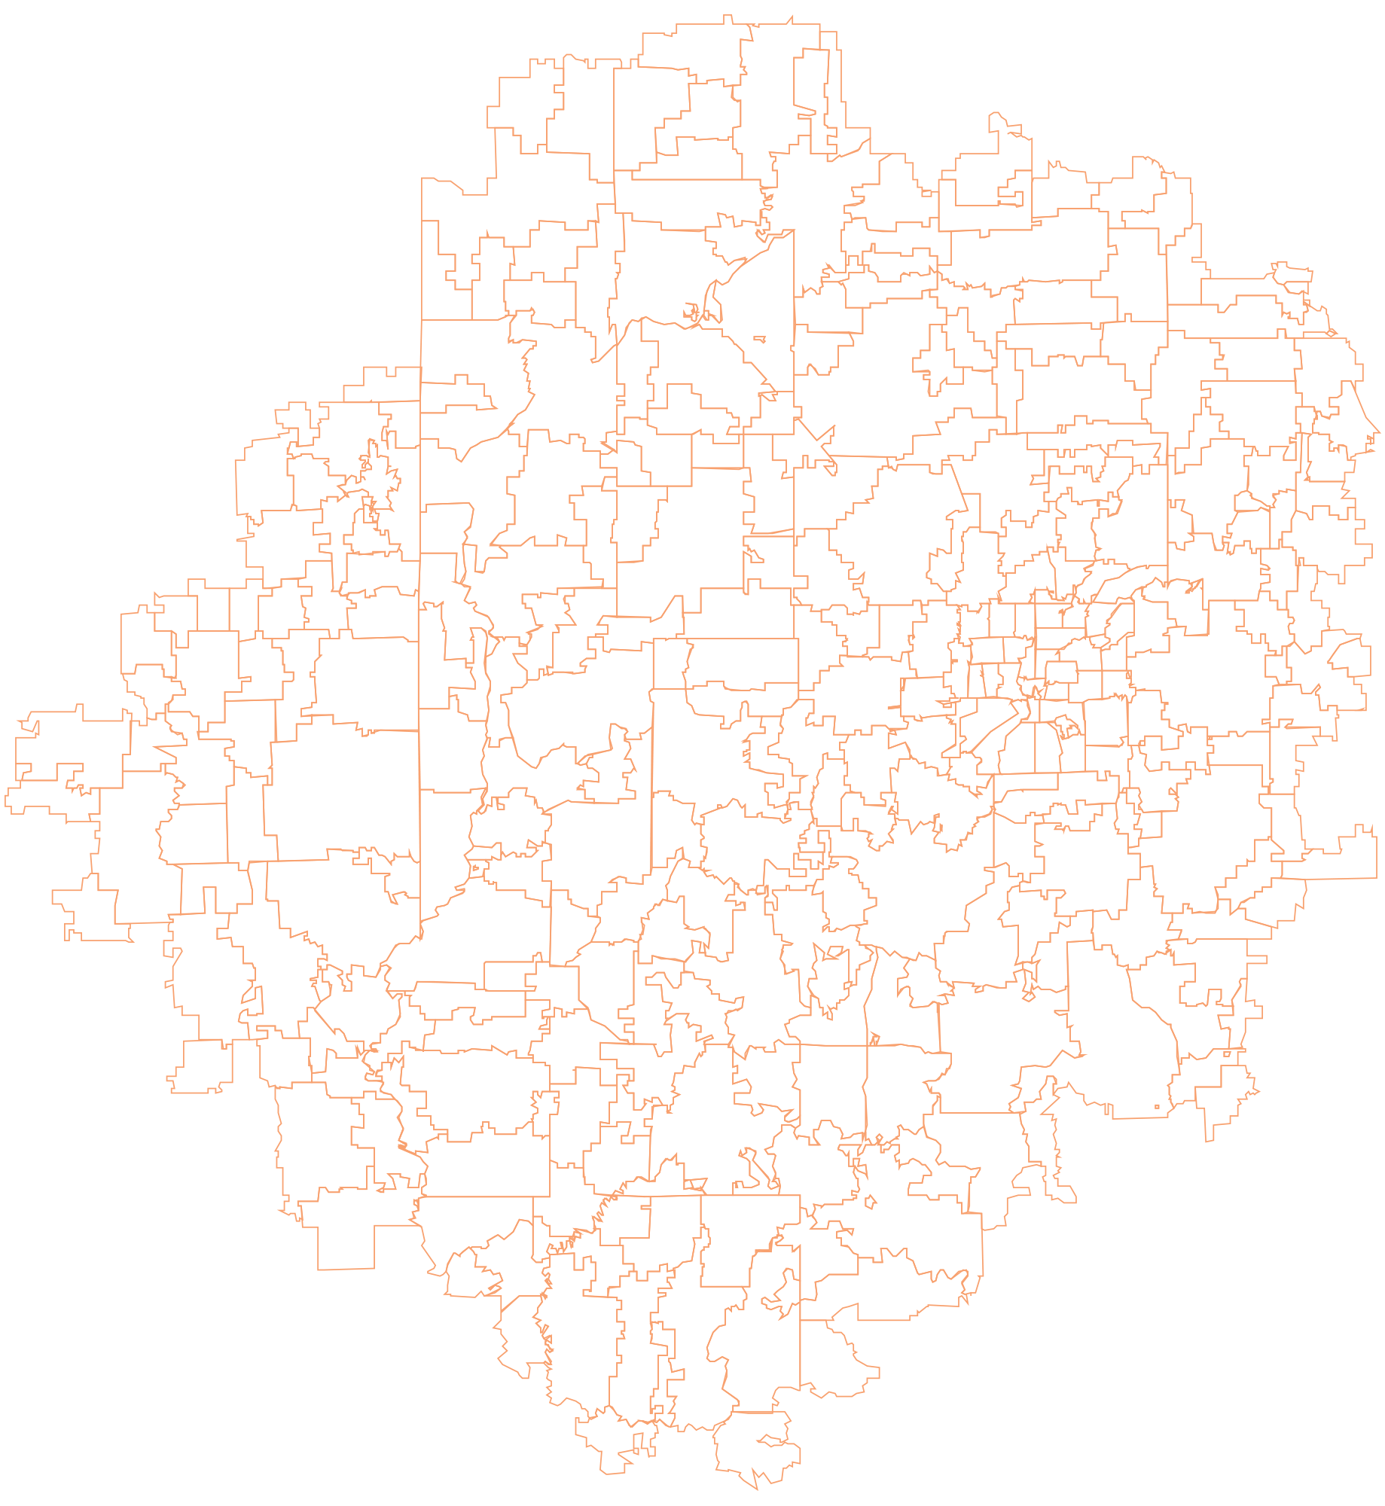


Notes:
G97350 UC Template for Esri staff

